Slide 1
Generative AI in Organisations: Challenges and Opportunities
ODSC Europe 2023 – Heiko Hotz

Slide 2
Agenda
What is Generative AI & how does it work?
How to use Large Language Models (LLMs)?
Demo: Chat with your document
Bias and ethics in Generative AI

Slide 3
What is Generative AI?

Slide 4
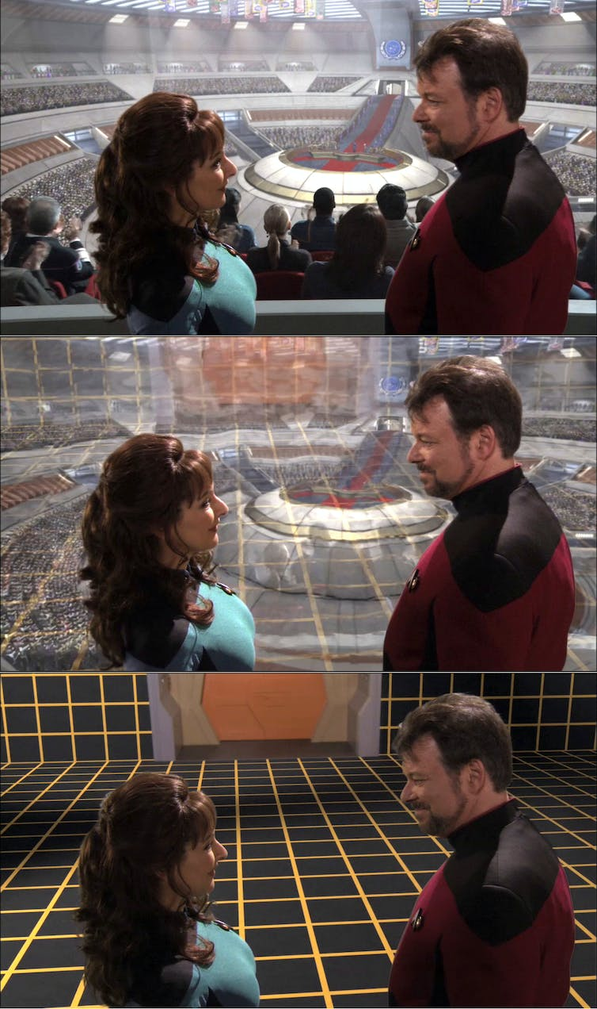
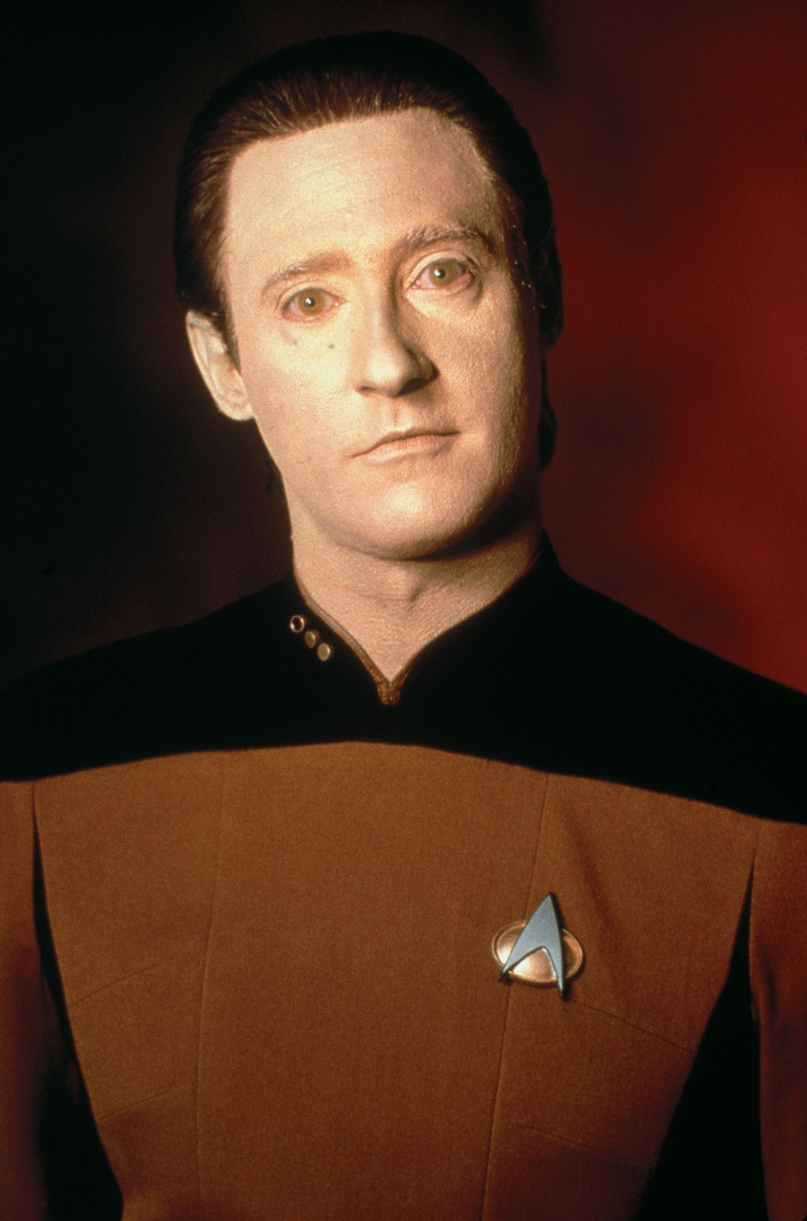
Generative AI – I grew up with it 😉
Source: https://www.fanpop.com/clubs/star-trek-the-next-generation/images/9406565/title/lt-commander-data-photo
Source: https://theconversation.com/star-treks-holodeck-from-science-fiction-to-a-new-reality-74839

Slide 5
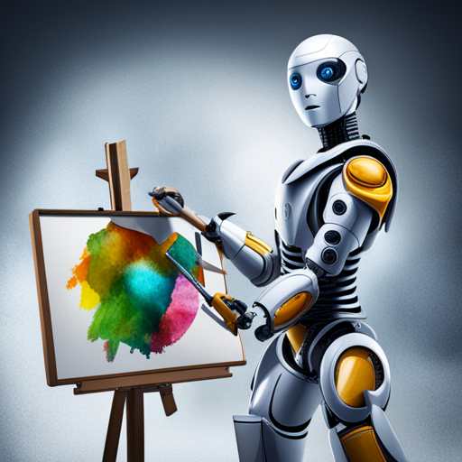
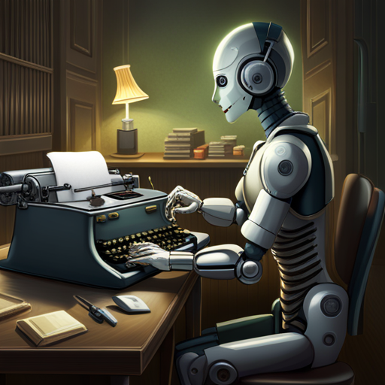

Generative AI – What is it?
AI that can produce original content close enough to human generated content for real-world tasks

Slide 6
How does it work (Text Generation Edition)?

Slide 7
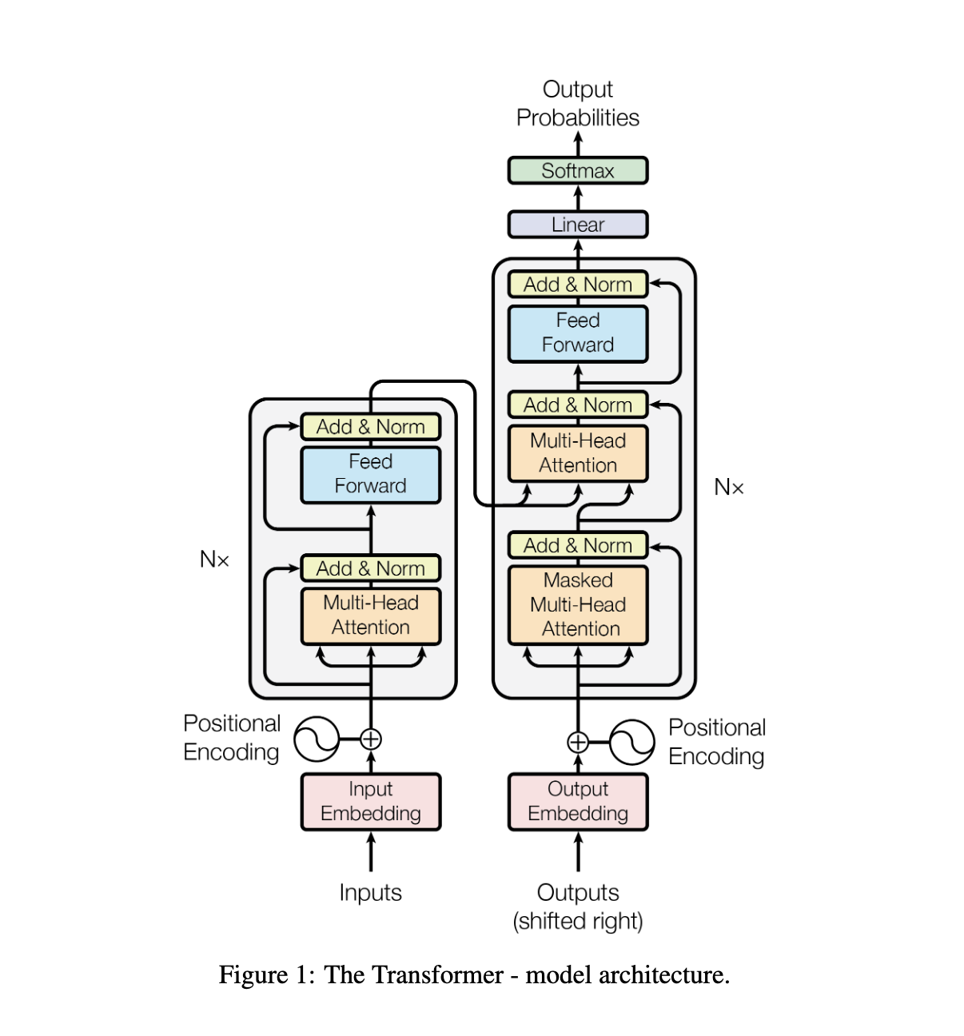
Transformer Architecture
Decoder
Encoder
Source: https://arxiv.org/pdf/1706.03762.pdf
(Attention is all you need)

Slide 8
Encoder-only models
Encoder:
Reads the entire input sequence & encodes the information
Bidirectional: It has access to all the words in the input sequence
Useful for tasks where the entire context needs to be taken into account
Example: Text classification with BERT (Bidirectional Encoder Representation from Transformers)
Encoder

Slide 9
Encoder-decoder models
Decoder
Encoder-Decoder:
Combines both abilities: Reading and understanding an input sequence and generating an output sequence
Sequence-to-sequence models (T5, BART)
Example: Translation
Encoder

Slide 10
Decoder-only models
Decoder
Decoder:
Generates output sequence one token at a time
Unidirectional: It has access only to the words to the left
Autoregressive: Each next token is predicted based on the tokens that came before
Example: Text generation (All GPT models are decoder-only)

Slide 11
How to train decoder-only models
Step1: Self-supervised pretraining
Feed the model with text from left to right and it learns to predict the next …
Self-supervised because it uses unlabelled data and creates the label on its own (by masking the next word)
Step 2: Train (finetune) the model on human feedback

Slide 12
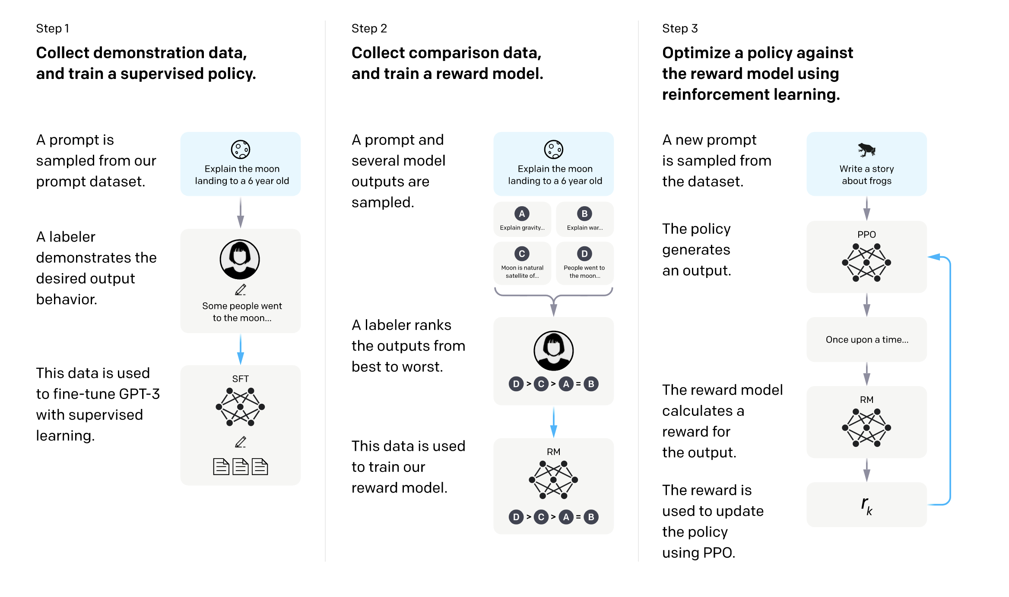
Training using human feedback

Slide 13
Agenda
What is Generative AI & how does it work?
How to use Large Language Models (LLMs)?
Demo: Chat with your document
Bias and ethics in Generative AI

Slide 14
How to deploy Large Language Models?

Slide 15
There are different ways to use LLMs
API-based (OpenAI)
Self-hosted on local machine
Hosted in Cloud

Slide 16
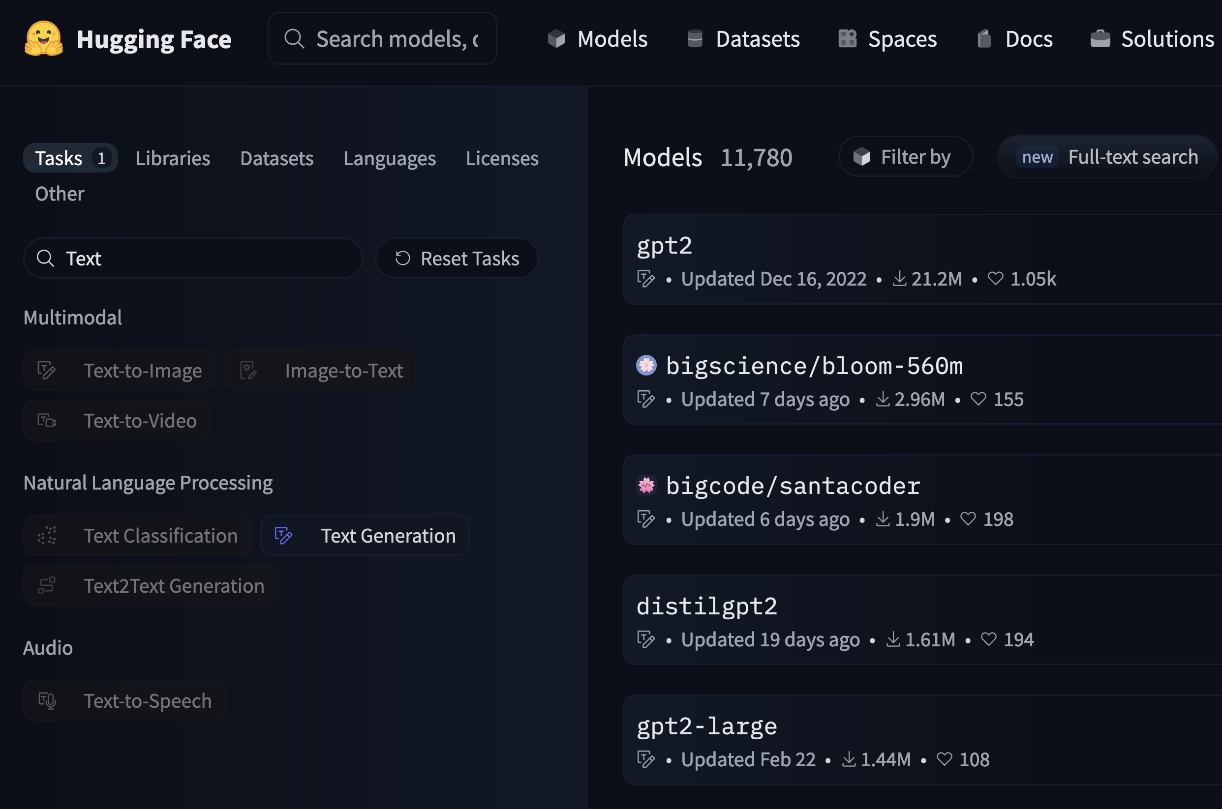
Self-hosting

Slide 17
Challenge with self-hosting
GPU Memory!

Slide 18
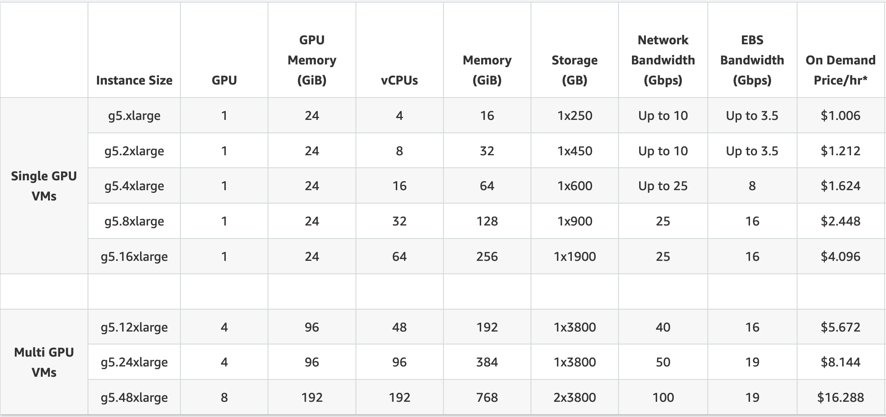
Cloud providers can help
Source: https://aws.amazon.com/ec2/instance-types/g5/

Slide 19
How to use Large Language Models?

Slide 20
API use
<SCREENSHOT>

Slide 21
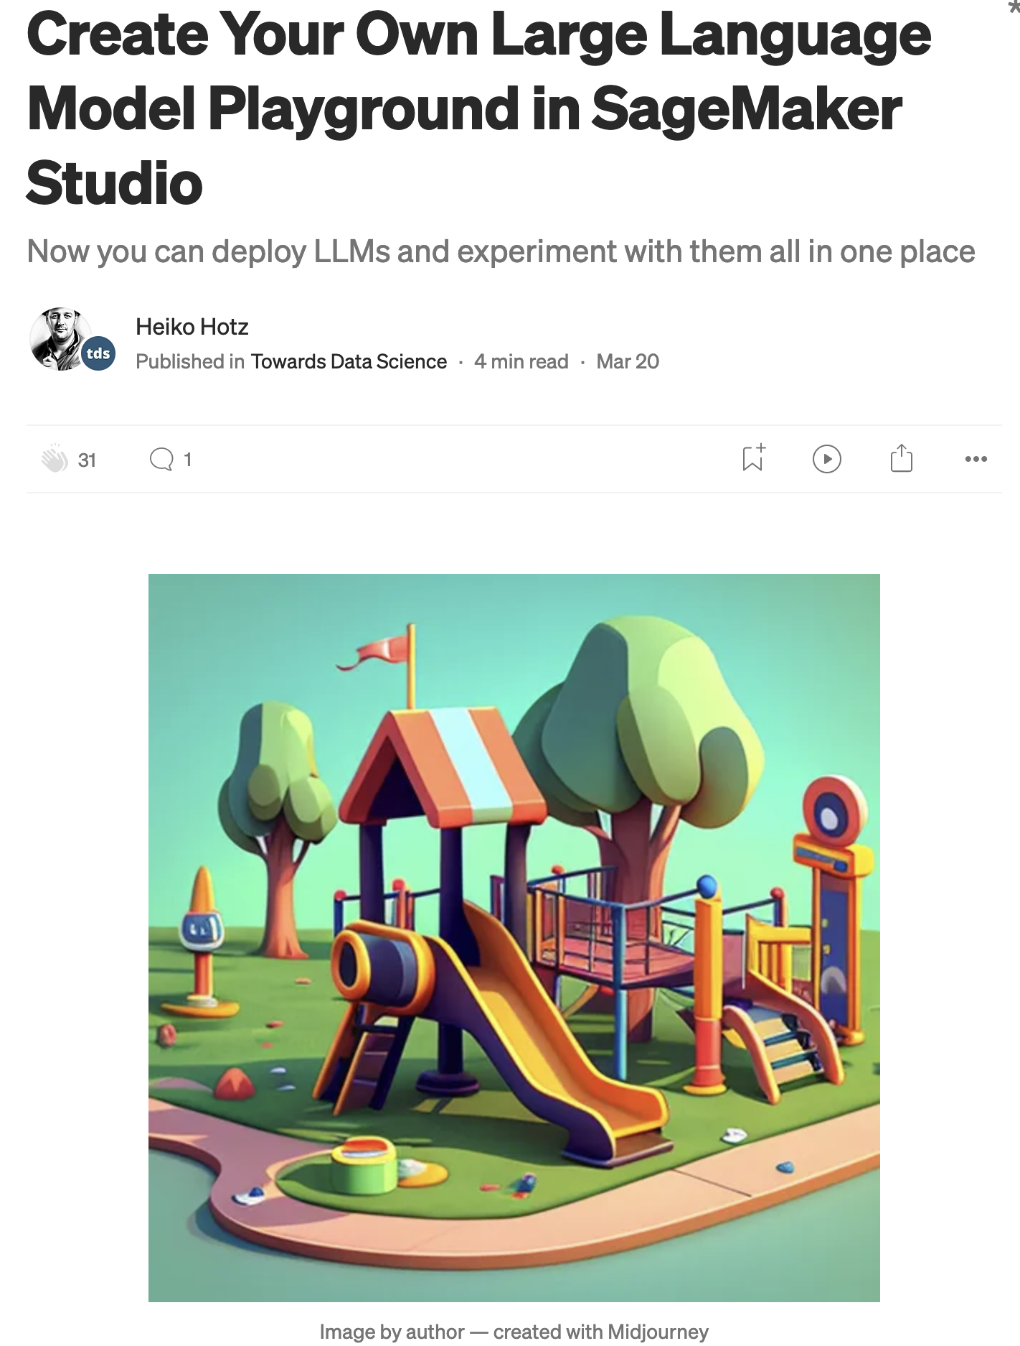
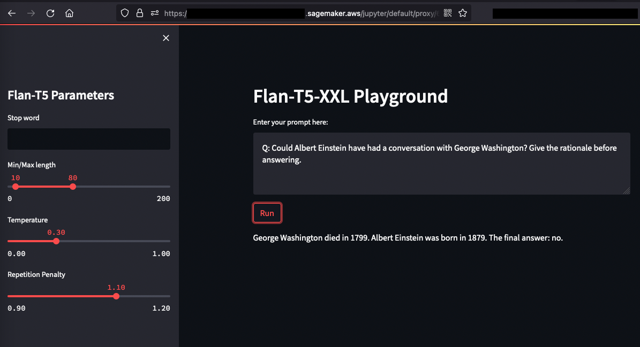
Better: playground

Slide 22
How to build applications with LLMs?

Slide 23
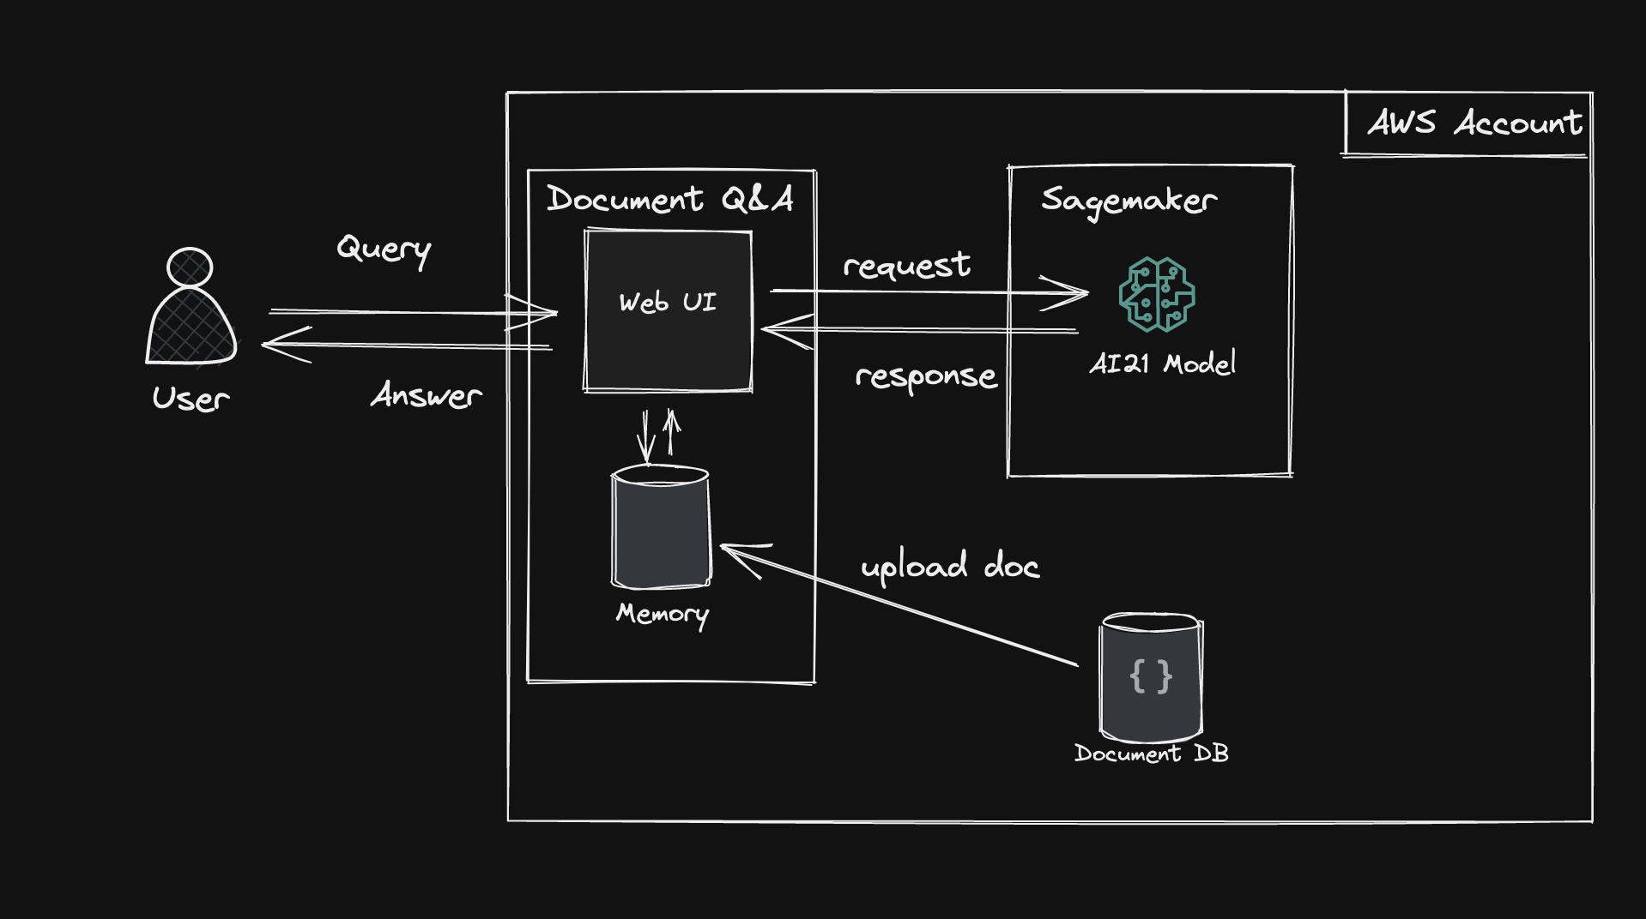
Architecture

Slide 24
Demo

Slide 25
Agenda
What is Generative AI & how does it work?
How to use Large Language Models (LLMs)?
Demo: Chat with your document
Bias and ethics in Generative AI

Slide 26
Bias in LLMs
SCREENSHOT

Slide 27

Ethics with (Generative) AI
Source: https://edition.cnn.com/2023/05/04/tech/writers-strike-ai/index.html

Slide 28
Appendix

Slide 29
Neural Networks Recap
Input:
x
Hidden States:
h
Output:
y

Slide 30
Recurrent Neural Networks Recap
x(t-1)
x(t)
x(t+1)
Input:
…
t
…
Hidden States:
…
h(t-1)
h(t)
h(t+1)
…
Output:
…
y(t-1)
y(t)
y(t+1)
…

Slide 31
RNNs are useful for text generation
This
is
good
Encoder
Decoder
Das
ist
gut

